Slide 1

New Tools & R Packages for Tidy Time Series Analysis
R Panama, 2017-09-19
Matt Dancho Founder, Director of Product Development mdancho@business-science.io | www.business-science.io @bizScienc LinkedIn & Facebook github.com/business-science

Slide 2

About BizSci

Slide 3
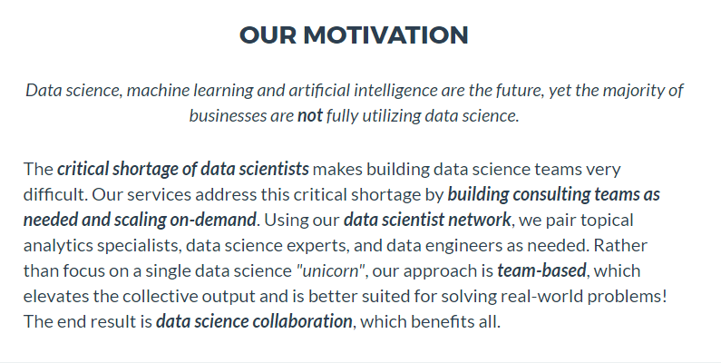
About BizSci

Slide 4
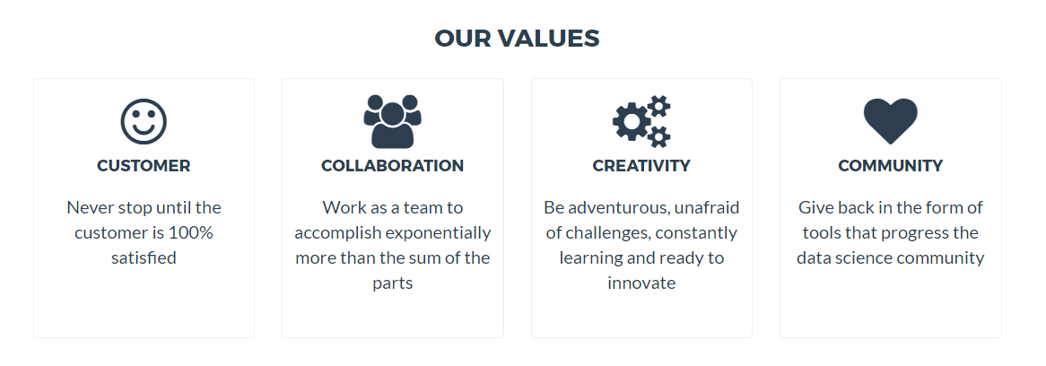
About BizSci

Slide 5
Before we begin demos…
All Presentation Materials Here
github.com/business-science
/presentations/
2017_09_19_R_UserGroup_Panama

Slide 6



About BizSci
OUR R PACKAGES
tibbletime
logo coming soon

Slide 7
{tidyquant}: Financial & Time Series Analysis
Getting data from web
Yahoo! Finance, FRED Database, Quandl and more
Tidy application of financial and time series functions
{xts}, {zoo}, {quantmod}, {TTR} and {PerformanceAnalytics}
Graphing - Beautiful ggplot themes and financial geoms
Working with portfolios
Financial performance analysis and portfolio attribution metrics
Base package for any analysis

Slide 8
{tidyquant}: Financial & Time Series Analysis
DEMO

Slide 9
{timetk}: Toolkit for Time Series Analysis
Coercing (converting) between time classes in R
Convert between {tbl}, {xts}, {zoo}, {ts}
Time series machine learning

Slide 10
timetk: Toolkit for Time Series Analysis
DEMO

Slide 11
sweep: Broom-Style Tidiers for forecast pkg
Tidying the {forecast} package workflow.
{broom} is to {stats} as {sweep} is to {forecast}
Forecast package works with {ts}
Tidyverse works with {tbl}

Slide 12
sweep: Broom-Style Tidiers for forecast pkg
DEMO

Slide 13
{tibbletime}: time-aware tibbles
This is the future of tidy time series analysis
Sits on top of {tbl} as new class {tbl_time}
Special time-based functions
time_filter()
time_summarize()
as_period()
time_collapse()
tmap()
More coming soon!!!
tibbletime
logo coming soon

Slide 14
tibbletime: time-aware tibbles
DEMO
tibbletime
logo coming soon

